Slide 1

LITERACY RATE OF INDIA SHAIMA AFREEN

Slide 2
OUTLINE
Executive Summary
Introduction
Methodology
Visualization
Insights
Conclusions

Slide 3
EXECUTIVE SUMMARY
This is a WebScraping project. In this project we are analyzing the literacy rate of India.
Here I have used python’s Requests, BeautifulSoup module to web scrape the data for my project.
Later converted the data to data frames using python’s pandas module.
The following are the websites I used for WebScraping the data:
https://www.theglobalstatistics.com/literacy-rate-in-india/
https://www.macrotrends.net/countries/IND/india/literacy-rate
https://worldpopulationreview.com/country-rankings/literacy-rate-by-country
After creating data frames from the scraped data, we saved the data frames to .csv file.
Later imported the datasets to power BI.
Performed few transformations on the data.
Analyzed the data by using various visualization charts on power BI.

Slide 4
INTRODUCTION
The aim of this project is to web scrape the data. The data we want to web scrape is the literacy rate of India in different years.
Here we are using following modules:
bs4: BeautifulSoup is a python library for pulling data out of HTML and XML files.
requests: This module allows us to send HTTP requests extremely easy.
After getting all the required data,I am using Power BI to analyze and visualize the data.

Slide 5


METHODOLOGY
First imported all the required modules.
Then we used requests’s modules ‘get’ method to get the content from the webpage.
We created a BeautifulSoup object to parse and scrape HTML page.
Then we used ‘find_all’ method to get all the tables on the webpage.
After scraping all the required data, we saved the data frames to .csv format.
Imported the data to power BI.
Did few transformations like changing the data type of the required columns.
Used various charts from power BI to visualize the data.

Slide 6
VISUALIZATION
Analyzed data by using different visualizations present in the Power BI desktop application.
Used card to display the highest literacy state, lowest literacy rate etc.
Used line graph to visualize the literacy rate of India from 1980 to 2018.
Similarly used various graphs to visualize the data.
The link to report is:
https://app.powerbi.com/links/omt0Hueo-g?ctid=2335c322-430f-4695-8746-529dd25ed072&pbi_source=linkShare&bookmarkGuid=7cdc22a4-0358-41af-9864-4994d55a19d5

Slide 7
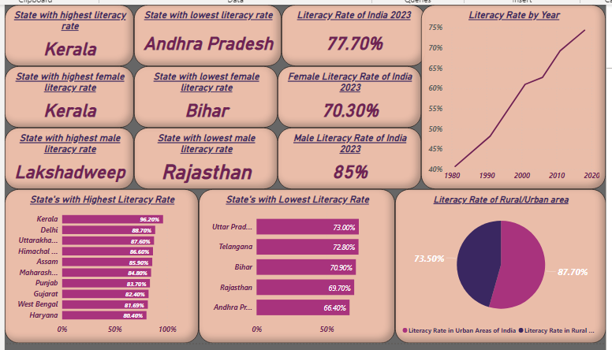
INSIGHTS
We analyzed the following things:
The literacy rate of India in 2023 is 77.70%.
The state with highest literacy rate is Kerala and with lowest literacy rate is Andhra Pradesh.
We can see that literacy rate of India has increased from 1980 to 2018.

Slide 8
CONCLUSIONS
The literacy rate of India in 2023 is 77.70%.
The state with highest literacy rate is Kerala and with lowest literacy rate is Andhra Pradesh.
We can see that literacy rate of India has increased from 1980 to 2018.
The literacy rate for women is less compared to literacy rate of men.
The literacy rate for particular religions and caste is low, we need to try to focus on these area and try to increase the overall literacy rate of India.

Slide 9
THANK YOU

